Slide 1

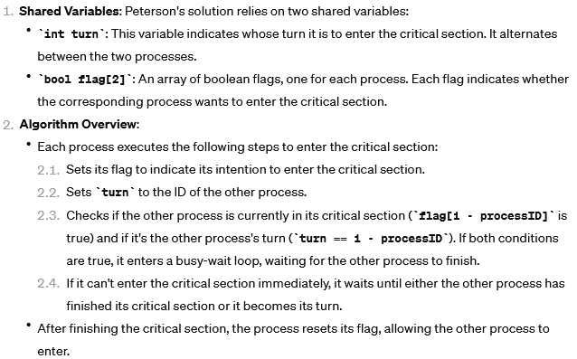
Peterson’s Solution

Slide 2
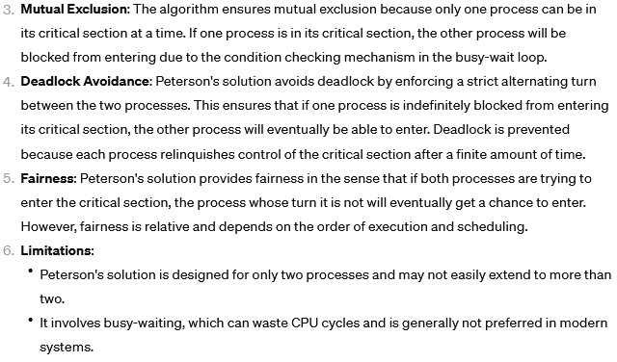
Peterson’s Solution

Slide 3
Peterson’s Solution
Two process solution
Assume that the load and store machine-language instructions are atomic; that is, cannot be interrupted
The two processes share two variables:
int turn;
boolean flag[2]
The variable turn indicates whose turn it is to enter the critical section
The flag array is used to indicate if a process is ready to enter the critical section.
flag[i] = true implies that process P_{i} is ready!

Slide 4
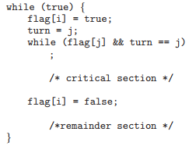
Algorithm for Process P_{i}

Slide 5
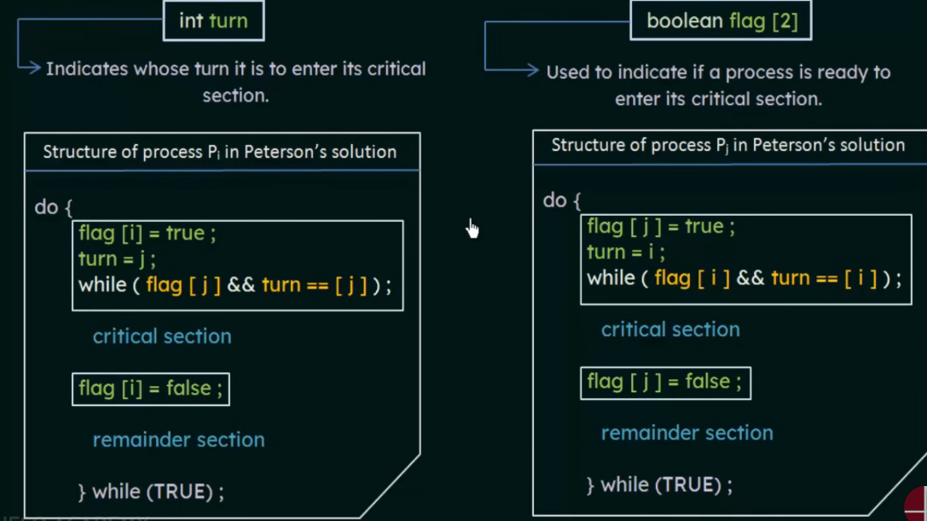
Peterson’s Solution

Slide 6
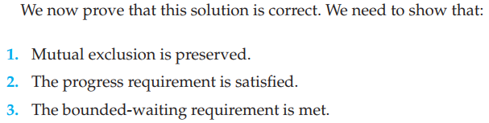
Correctness of Peterson’s Solution

Slide 7
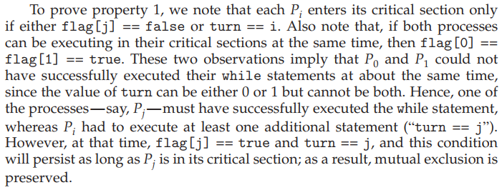

Slide 8

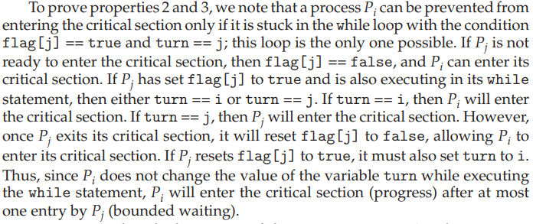

Slide 9
Peterson’s Solution and Modern Architecture
Although useful for demonstrating an algorithm, Peterson’s Solution is not guaranteed to work on modern architectures.
To improve performance, processors and/or compilers may reorder operations that have no dependencies
Understanding why it will not work is useful for better understanding race conditions.
For single-threaded this is ok as the result will always be the same.
For multithreaded the reordering may produce inconsistent or unexpected results!

Slide 10
Peterson’s Solution and Modern Architecture
Peterson’s solution is not guaranteed to work on modern computer architectures for the primary reason that, to improve system performance, processors and/or compilers may reorder read and write operations that have no dependencies.
For a single threaded application, this reordering is immaterial as far as program correctness is concerned, as the final values are consistent with what is expected.
This is similar to balancing a checkbook—the actual order in which credit and debit operations are performed is unimportant, because the final balance will still be the same.
But for a multithreaded application with shared data, the reordering of instructions may render inconsistent or unexpected results.

Slide 11
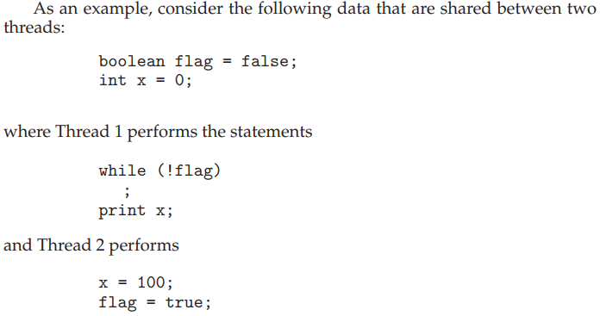
Modern Architecture Example
The expected behavior is, of course, that Thread 1 outputs the value 100 for variable x.
If due to reordering of instructions in Thread 2 so that flag is assigned true before assignment of x = 100.
Thread 1 would output 0 for variable x.
The processor may also reorder the statements issued by Thread 1 and load the variable x before loading the value of flag.
Thread 1 would output 0 for variable x even if the instructions issued by Thread 2 were not reordered.

Slide 12
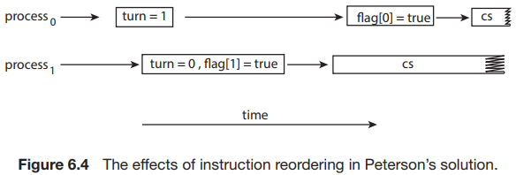
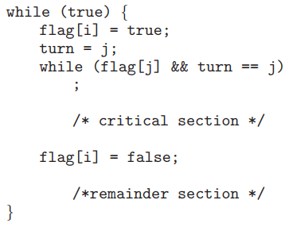
Instruction Reordering and Peterson’s Solution
Consider what happens if the assignments of the first two statements that appear in the entry section of Peterson’s solution in Figure 6.3 are reordered; it is possible that both threads may be active in their critical sections at the same time, as shown in Figure 6.4.

Slide 13
Instruction Reordering and Peterson’s Solution

